Slide 1

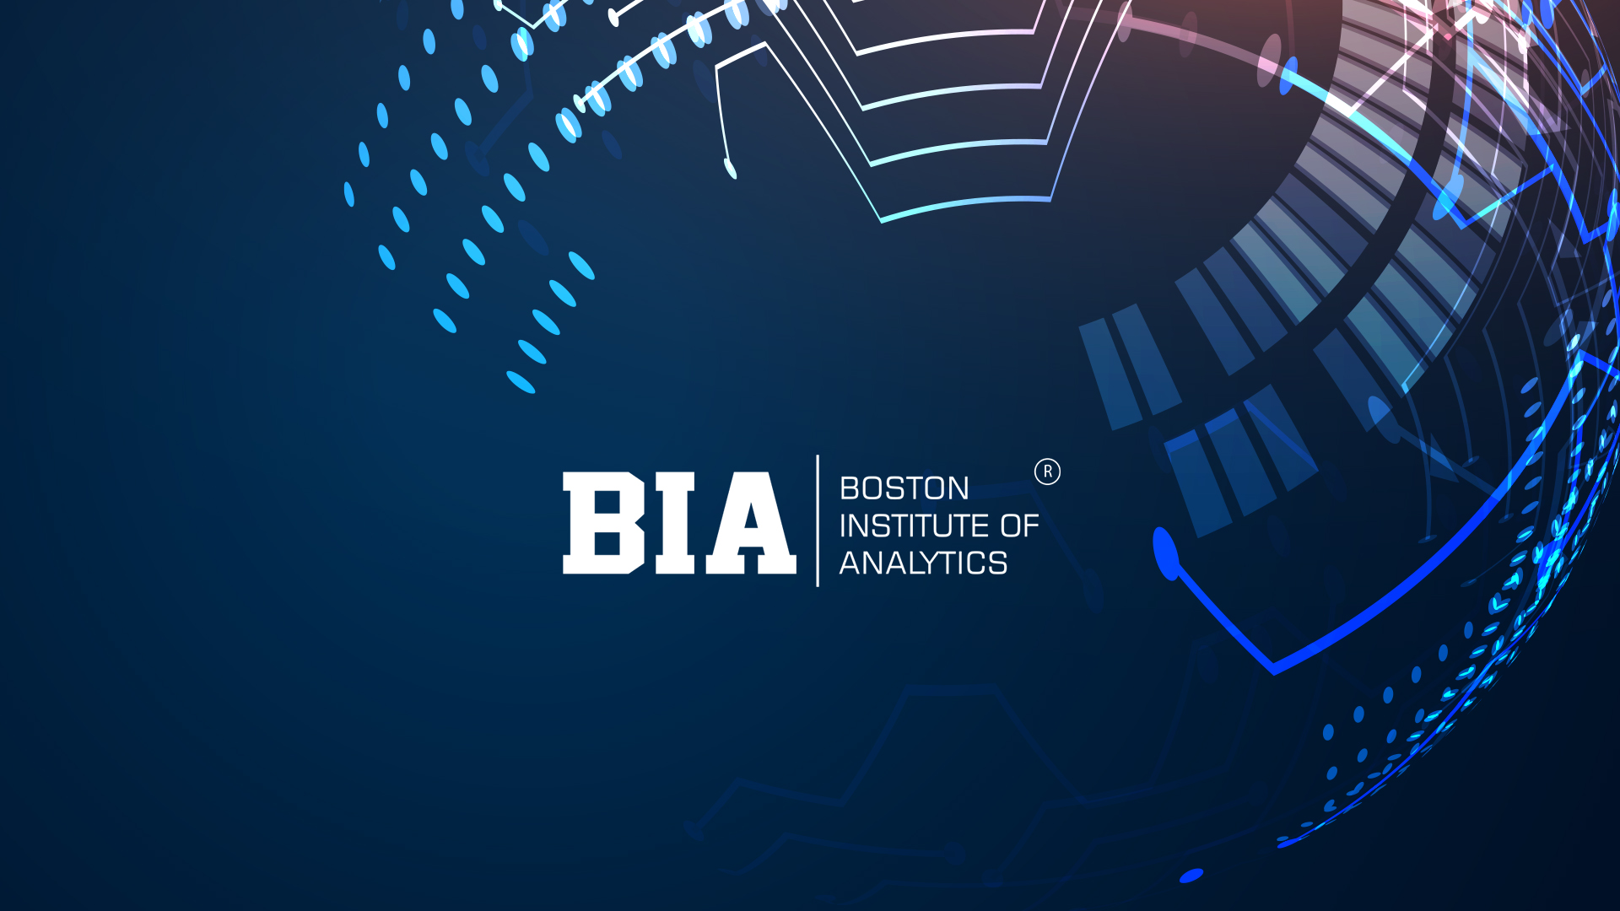

Solving the Business Problem: Digital Marketing Campaign Conversion Prediction
Improving Campaign targeting , increase conversion rates, and maximize return on advertising spend (ROAS)
Deveena Vig

Slide 2

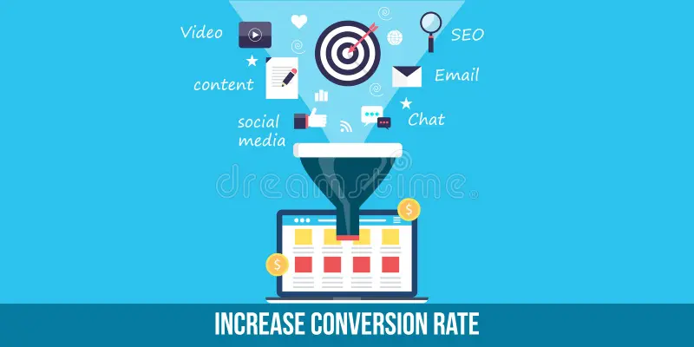
Problem Statement :
Marketers struggle to allocate budgets effectively due to uncertainty about customer behavior.
Misallocations lead to wasted resources and missed revenue opportunities.
By predicting customer conversions, this project seeks to minimize these inefficiencies and guide data-driven decision-making for better campaign outcomes.
The Objective of this project are as follows:
1. Develop a robust predictive model: Accurately predict whether a customer will convert based on demographic and engagement features.
2. Optimize marketing strategies: Improve campaign targeting, increase conversion rates, and maximize return on advertising spend (ROAS).

Slide 3
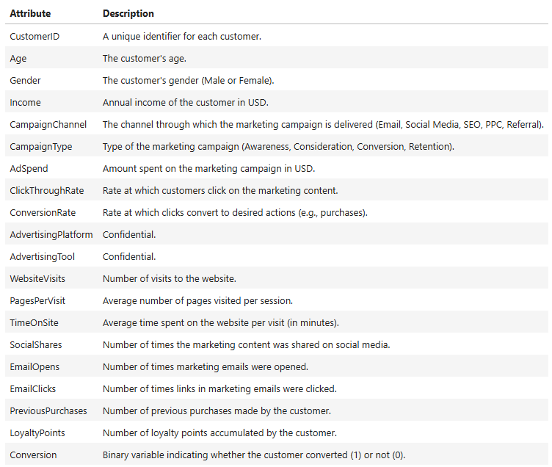
Dataset Description :
The dataset contains information on customers, including those who have converted (1) and those who have not converted (0).
Key dataset specifications: 8,000 rows & 20 columns
The dataset includes the following attributes:
Type of Machine Learning Task
Supervised Learning – Classification Task
As we haven to classify whether 1 or 0 (converted or not) on the basis of given feature (‘Conversion’)

Slide 4
Overview :
In this project, I aimed to predict customers converted to choose Digital Marketing campaigns using machine learning techniques. I performed extensive data analysis, including exploratory data analysis (EDA) to understand the characteristics of the dataset, and then proceeded with data preprocessing, model building, and evaluation.
I built three classification models: Decision Tree, Random Forest, Gradient Boosting, and CatBoost and evaluated their performance using two techniques:
Normal: without any balancing technique
Over-sampling: using SMOTE (Synthetic Minority Over-sampling Technique.)
I found that over-sampling produced overall better results but with some limitation of Over-fitting Risks. Among both the cases CatBoost consistently performed the best, offering a good balance of precision and recall for identifying churners.
Additionally, I visualized the performance of the model using Confusion Matrices, Classification Report and Precision-Recall Curve.
Overall, this project demonstrates the importance of addressing class imbalance in predictive modeling tasks with some limitations, especially in scenarios like digital marketing campaign conversion prediction, where identifying converted customers and improving campaign targeting accurately are crucial for business decision-making so as to optimize marketing strategies

Slide 5
Algorithms Used :
Decision Tree
Random Forest
Gradient Boosting
Simple, interpretable model that splits data based on key conversion factors. Helps identify key demographic & engagement features influencing conversions.
Ensemble of multiple Decision Trees for better accuracy & reduced overfitting. Useful for handling missing data and ranking feature importance in conversion prediction. More robust but computationally heavier than a single Decision Tree.
Optimized gradient boosting specifically designed for categorical data. Handles categorical features efficiently without extensive preprocessing. Faster training and improved performance on conversion prediction tasks.
Prone to overfitting but provides a baseline for model comparison.
Boosting technique that builds models sequentially to correct errors of previous ones. Performs well in predicting conversion probabilities by capturing complex patterns. Requires careful tuning to balance accuracy and prevent overfitting.
Cat Boost

Slide 6
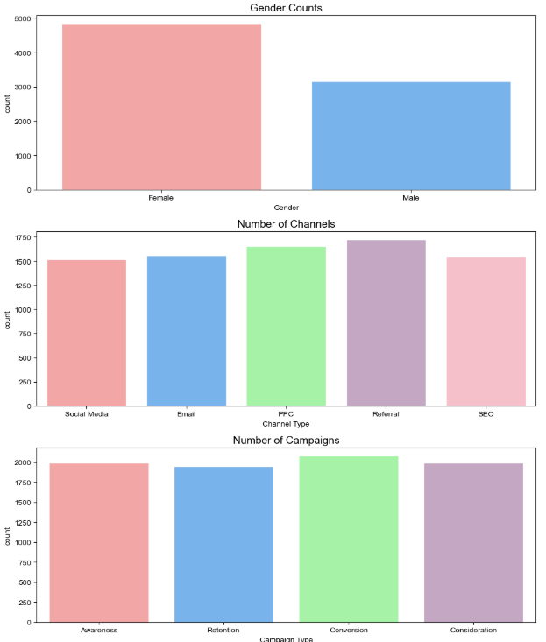
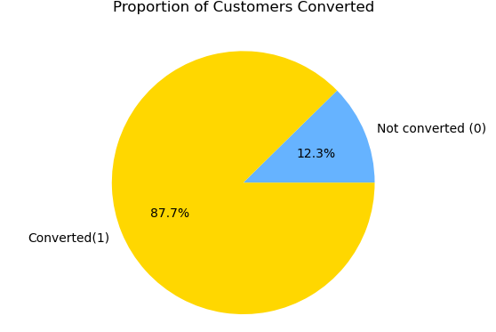
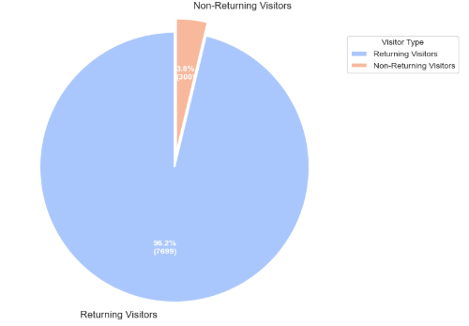
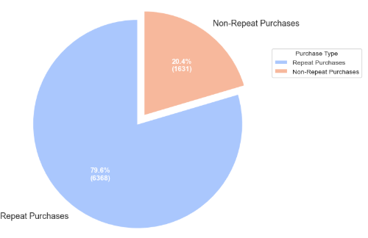
EDA (Exploratory Data Analysis) :
Data Cleaning
Dropped Unnecessary columns – "CustomerId“ , “AdvertisingPlatform”, “AdvertisingTool”
No nulls & duplicates were found.
No Outliers were found
Univariate Analysis
Dataset is Imbalanced (“Conversion”) –
1 – 87.7%
0 – 12.3%
Gender Distribution
Females are more
No. of Channels
Referral is more used
No. of Campaigns
Conversion is more used
Visitors Type
96.2% customers are returning after visiting the website
Purchase Type
79.6% customers are repeating purchases

Slide 7
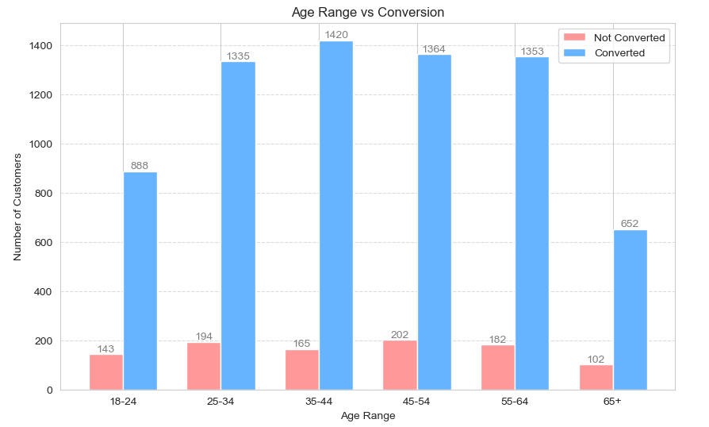
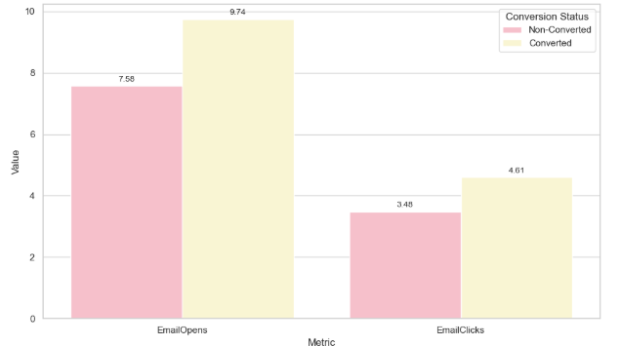
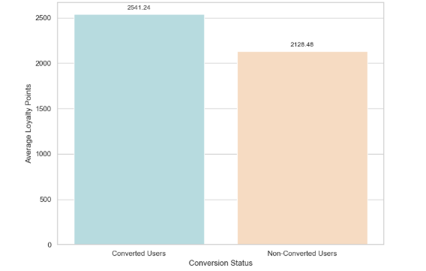
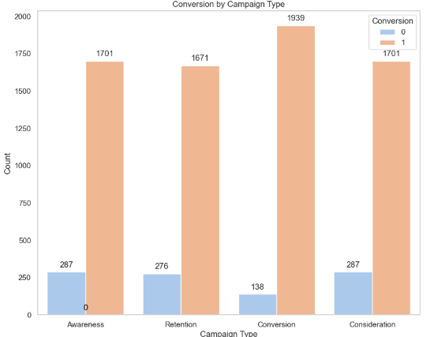
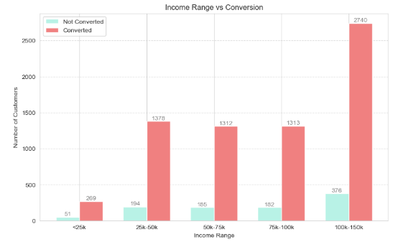
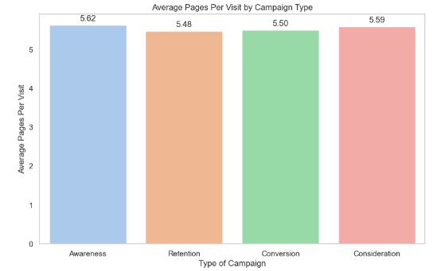
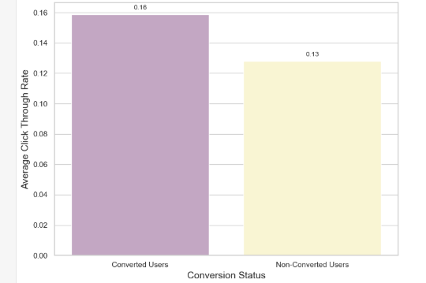
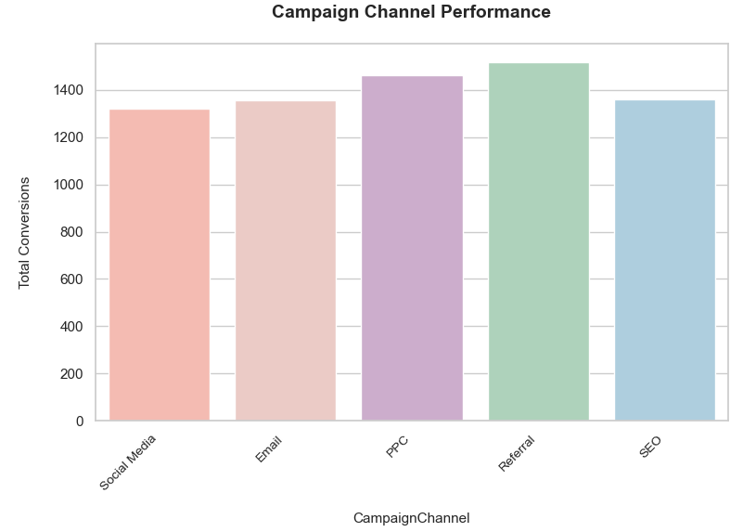
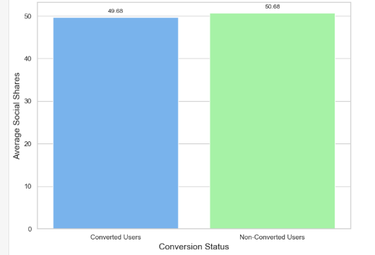
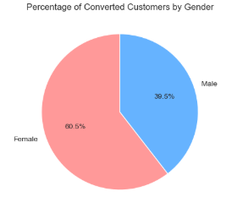
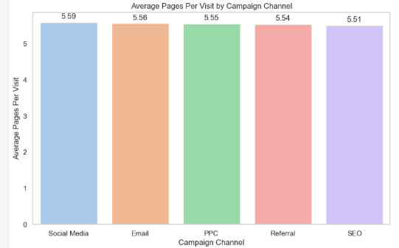
Bivariate Analysis:
Customer Demographic Analysis
Customer Engagement Metrics
Campaign Effectiveness Metric

Slide 8
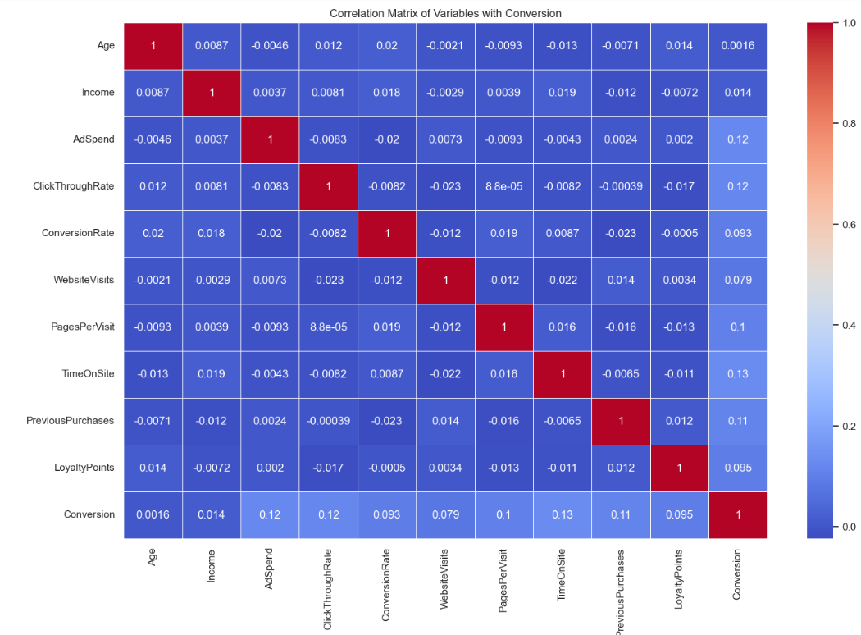
Multivariate Analysis:
The features AdSpend, ClickThroughRate, and TimeOnSite show the highest positive correlations with Conversion, though these correlations are still relatively weak. This suggests that while these factors are associated with higher conversion rates, they are not strong predictors on their own.
The features Conversion Rate and LoyalityPoint show weak correlations with Conversion suggesting that each variable might contribute uniquely to the conversion prediction, which could be beneficial when building a predictive model.
Correlation between PagePerVisit and TimeOnSite is positive but very low, suggesting that visiting more pages doesn’t necessarily mean spending more time on the site.
PreviousPurchaes and LoyaltyPoints correlation is positive but weak suggesting that customers who make previous purchases might accumulate loyalty points, but the relationship is not strong.
While some variables show positive correlations with conversion, the overall weak correlations imply that no single variable strongly drives conversion on its own. This indicates that a combination of multiple factors is likely necessary to accurately predict conversion, and machine learning models that consider the interactions between these variables may be more effective than relying on any single metric.

Slide 9
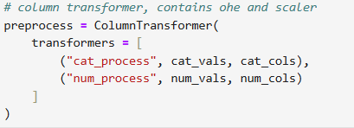
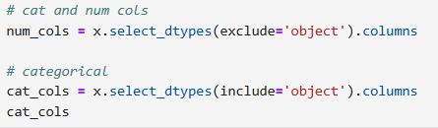
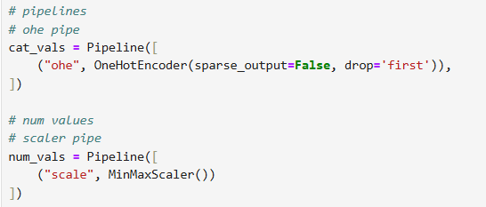
Data Preprocessing :
Converted Categorical Variables to numerical:
Separating categorical and numerical features allows us to apply the appropriate preprocessing techniques.
MinMaxScaler() scales numerical values between 0 and 1, ensuring all features are on the same scale.
Helps models like Decision Trees, Random Forest, and Gradient Boosting perform efficiently
Min Max Scaler:
One-Hot Encoding (OHE) converts categorical values into numerical form so that machine learning models can process them.
Pipeline ensures these steps happen in sequence automatically
Column Transformer:
Applies OHE to categorical features and scaling to numerical features in one step.
Saves time and prevents manual preprocessing errors.

Slide 10
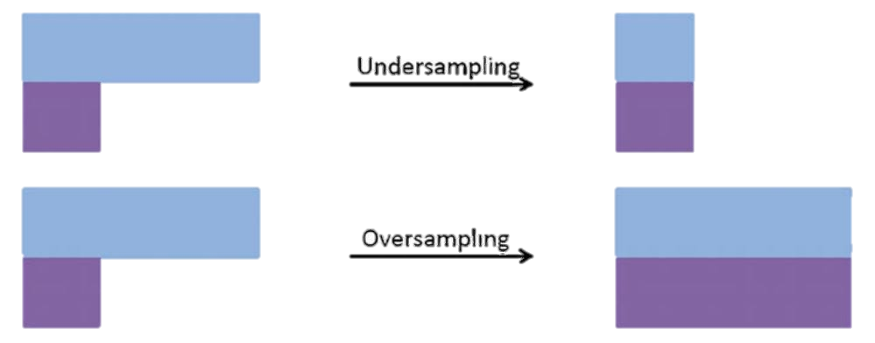
Model Building:
In model building , machine learning algorithms are trained on historical data to make predictions.
ML Algorithm that I have used is Decision Tree, Random Forest, Gradient Boosting and Cat Boost
Two techniques were employed for building and evaluating predictive models for digital marketing campaign conversion model:
Normally
Models built without any balancing technique
Over-Sampling
SMOTE (Synthetic Minority Over-sampling Technique) -
a smarter way to oversample, it creates synthetic samples that are similar to the existing minority class samples.
Adding more copies of the minority class to balance the dataset.

Slide 11
Evaluation Matrix of Classification Task:
Confusion Matrix
True Positives (TP): Instances that were correctly classified as positive.
Classification Report
Precision: The proportion of correctly predicted instances of a class out of all instances predicted as that class
Recall : The proportion of correctly predicted instances of a class out of all instances that truly belong to that class.
True Negatives (TN): Instances that were correctly classified as negative.
False Positives (FP): Instances that were incorrectly classified as positive.
False Negatives (FN): Instances that were incorrectly classified as negative.
F1- score : It is a combination of precision and recall into a single value. It gives you a balanced measure of how well model is performing.
Accuracy : the proportion of correctly classified instances out of the total instances.

Slide 12
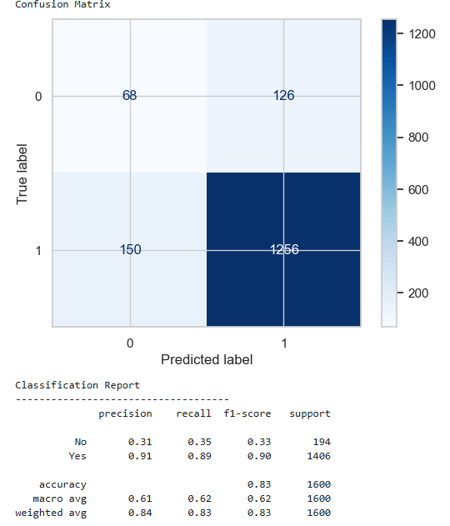
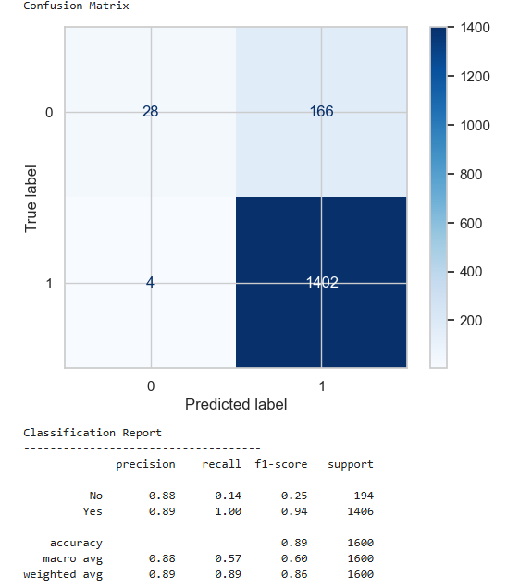
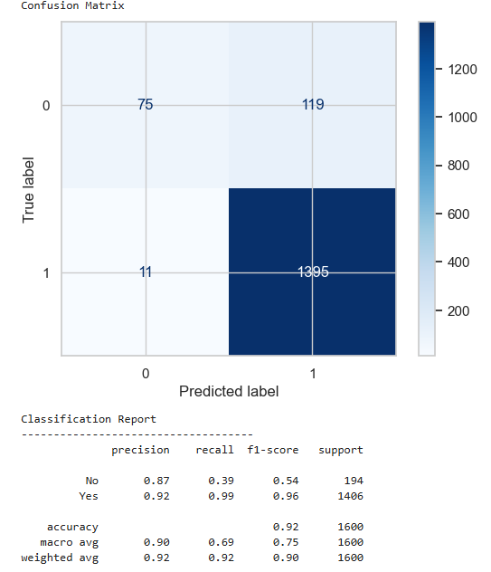

Evaluation Matrix (without balancing) :
Decision Tree
Random Forest
Gradient Boosting
Cat Boost
Insights:
Decision Tree performance slightly lags , there is high Type 1 and Type 2 error with an imbalance of F1 Score.
Random Forest performs slightly better than Decision Tree , with low F1 Score .There is high Precision and low Recall.
Gradient Boosting performance has improved with little imbalance , now there is better balance between F1 Score and the Precision has improved too.
CatBoost performs the best among all the above models with improving the F1 Score , minimizing the imbalance , giving a better judgement of converted and non converted customers.

Slide 13

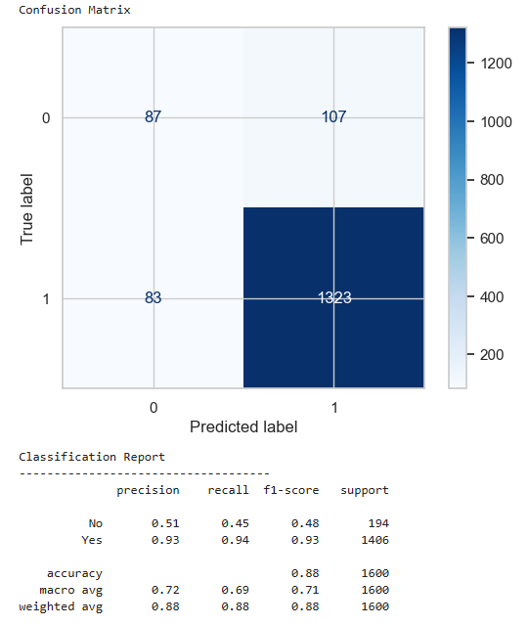
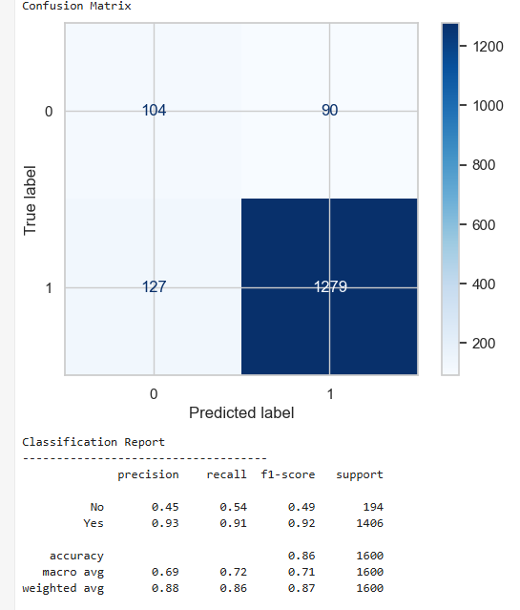
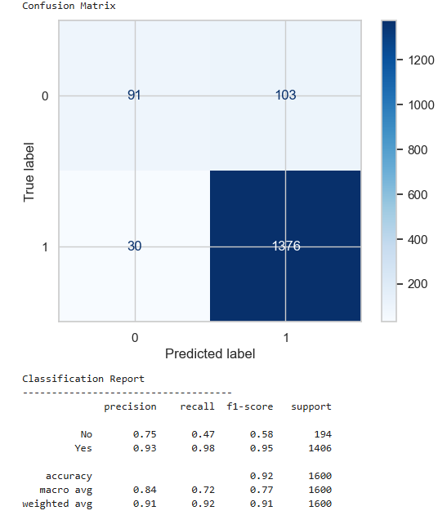
Evaluation Matrix (Over-sampling) :
Decision Tree
Random Forest
Gradient Boosting
Cat Boost
Insights:
Decision Tree with SMOTE doesn’t perform well , it has imbalance and noise leading it to not perform well.
Random Forest with SMOTE improved significantly from previous one creating better F1 score and other metrices.
Gradient Boosting with SMOTE the F1 Score has improved , but Recall increasing but the model is able to identify Conversions better than other models
CatBoost with SMOTE performs the best among the above mentioned models , Recall has also decreased which is good as per the problem statement.

Slide 14
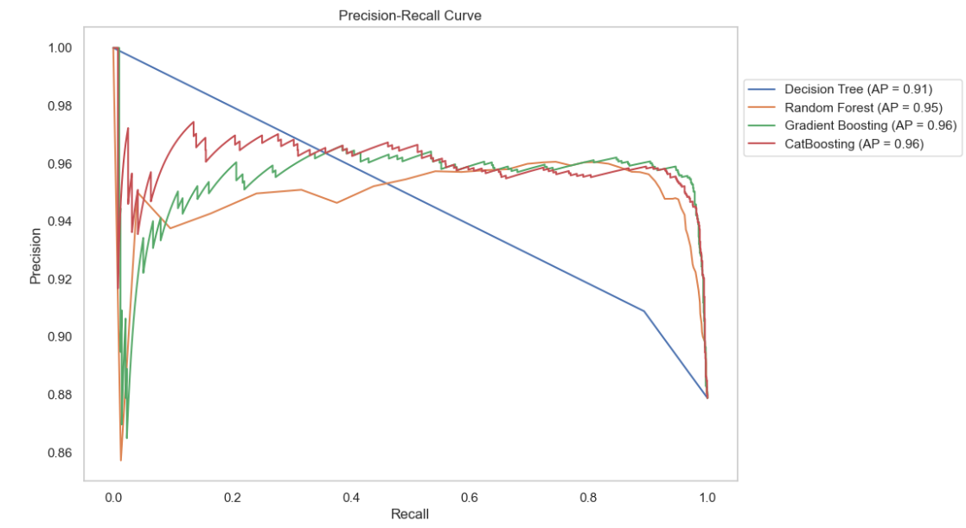
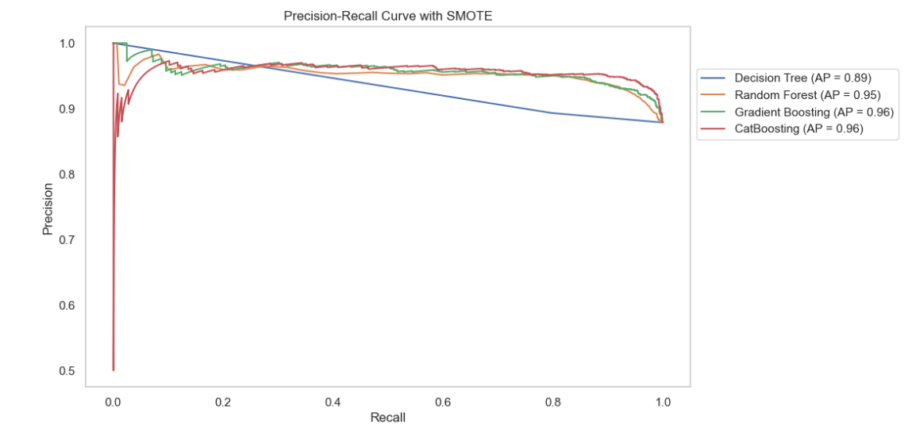
Precision Recall Curve :
CatBoosting has the highest AP (0.96), followed by Gradient Boosting (0.96), Random Forest (0.95), and then Decision Tree (0.91). This means CatBoost and Gradient Boosting are better at maintaining high precision and recall simultaneously.
As High recall is likely more critical since missing potential conversions could mean lost revenue,CatBoosting or Gradient Boosting should be preferred, given their higher performance across recall values.
CatBoosting and GradientBoosting models excel due to their ability to capture non-linear patterns and handle complex feature interactions. Their higher AP values and curve shapes show they balance precision and recall well.
Random Forest erforms well (AP = 0.95), it slightly underperforms compared to boosting models because it might be less optimized for feature weighting or minority class sensitivity.
Decision Tree lacks the robustness of ensemble methods, leading to poorer precision and recall across thresholds.

Slide 15
Conclusion :
Top Performers: CatBoostClassifier stands out as the best model with the highest accuracy and balanced performance across both classes, making it ideal for scenarios where both precision and recall are critical.
CatBoostClassifier performs well keeping in mind the objective of the project which is accurately predict whether a customer will convert based on demographic and engagement features. This was applied by giving more importance to Recall.
Areas for Improvement: The DecisionTreeClassifier, RandomForestClassifier, and GradientBoostingClassifier perform well but have difficulty predicting non-converted customers (class 0). Further fine-tuning or feature engineering could improve their overall effectiveness.
Limitations :
While CatBoosting performs exceptionally well in both cases i.e with or without SMOTE, it is not without limitations:
Overfitting Risk: As a powerful ensemble method, CatBoost can overfit to the training data if not properly tuned or if the data is noisy. This could lead to reduced performance on unseen data.

Slide 16
Recommendation:
Improve Ad Creatives: Boost CTR by making ads more engaging.
Enhance Website Content: Encourage more page visits and longer time on site
Optimize Email Campaigns: Increase opens and clicks with better subject lines and email content.
Focusing on these areas and regularly monitoring the metrics can improve the marketing strategies and drive more conversions, leading to better results for the client
Future Improvement :
Actionable Insights and Next Steps Given the model’s strong performance, i recommend proceeding with deploying the CatBoost model with the following considerations:
Regular Monitoring: Implement continuous monitoring of model performance to detect and address any decline in accuracy, particularly due to data drift or unforeseen biases.
Business Integration: Work closely with stakeholders to integrate model predictions into business processes, ensuring that the model's outputs are used effectively to drive decisions.
Use advanced techniques like ADASYN and SMOTE-Tomek Links to reduce noise..

Slide 17
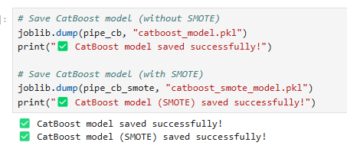
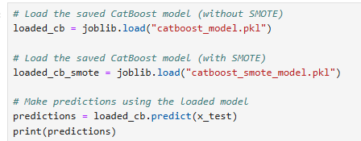
Application of this model in other industries:
E-Commerce & Retail – Boost online sales by targeting high-intent shoppers.
Banking & Finance – Improve lead conversion for loans, credit cards, and investment products.
Healthcare & Insurance – Enhance patient engagement and optimize policy sales.
EdTech & Online Learning – Increase course enrollments through personalized marketing.
Saving and Loading CatBoost Model :

Slide 18
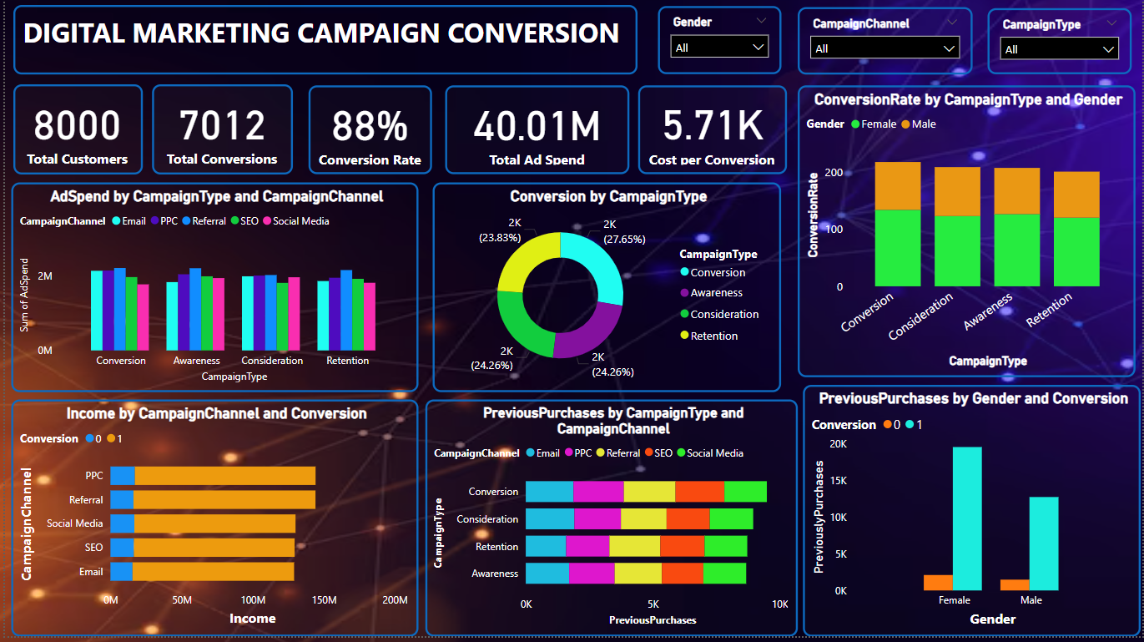
Power BI Dashboard :

Slide 19
Key Insights of Power BI Dashboard
The campaign is highly effective with 88% conversion rate.
There are 8000 customers out of which 7012 customers were converted for digital marketing campaigns.
40.01 millions is spend for Advertisement and the cost per customer is 5.71 thousand.
Awareness and Retention campaigns have the highest ad spend.
Awareness campaigns need optimization due to lower conversions.
PPC and Social Media are strong performers in both revenue and previous purchases.
Female customers show stronger engagement and repeat purchases.

Slide 20


